Slide 1


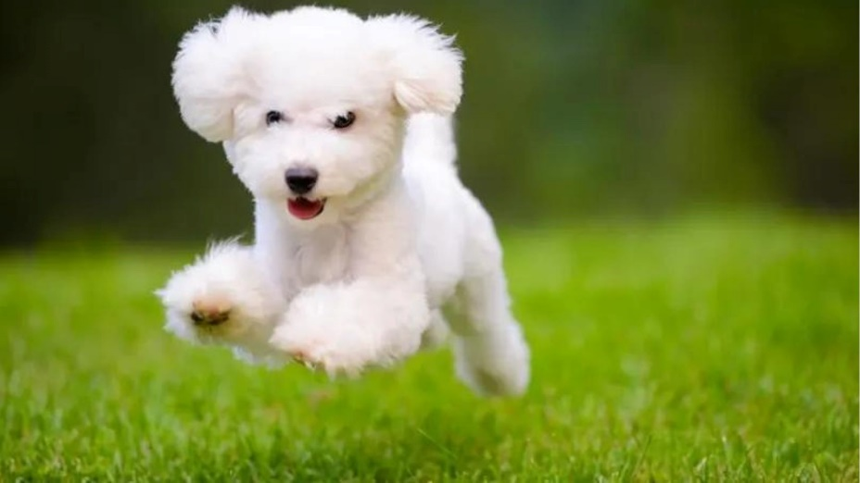
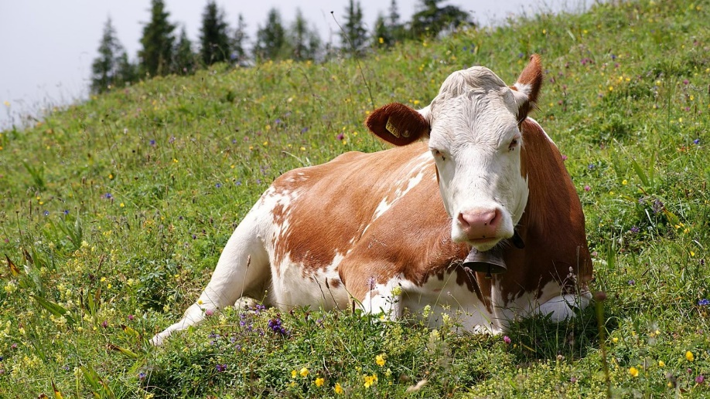
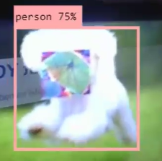
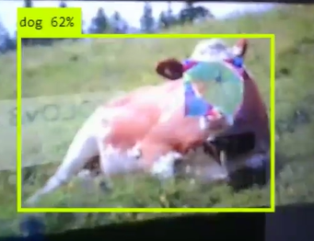
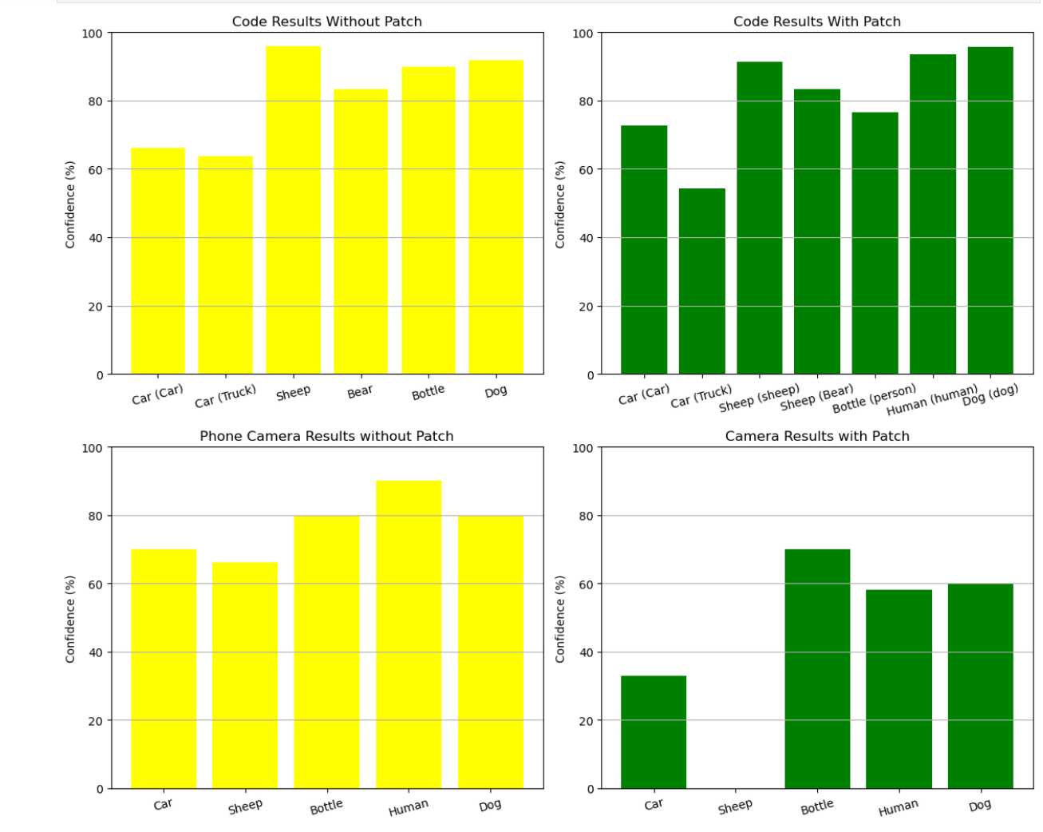
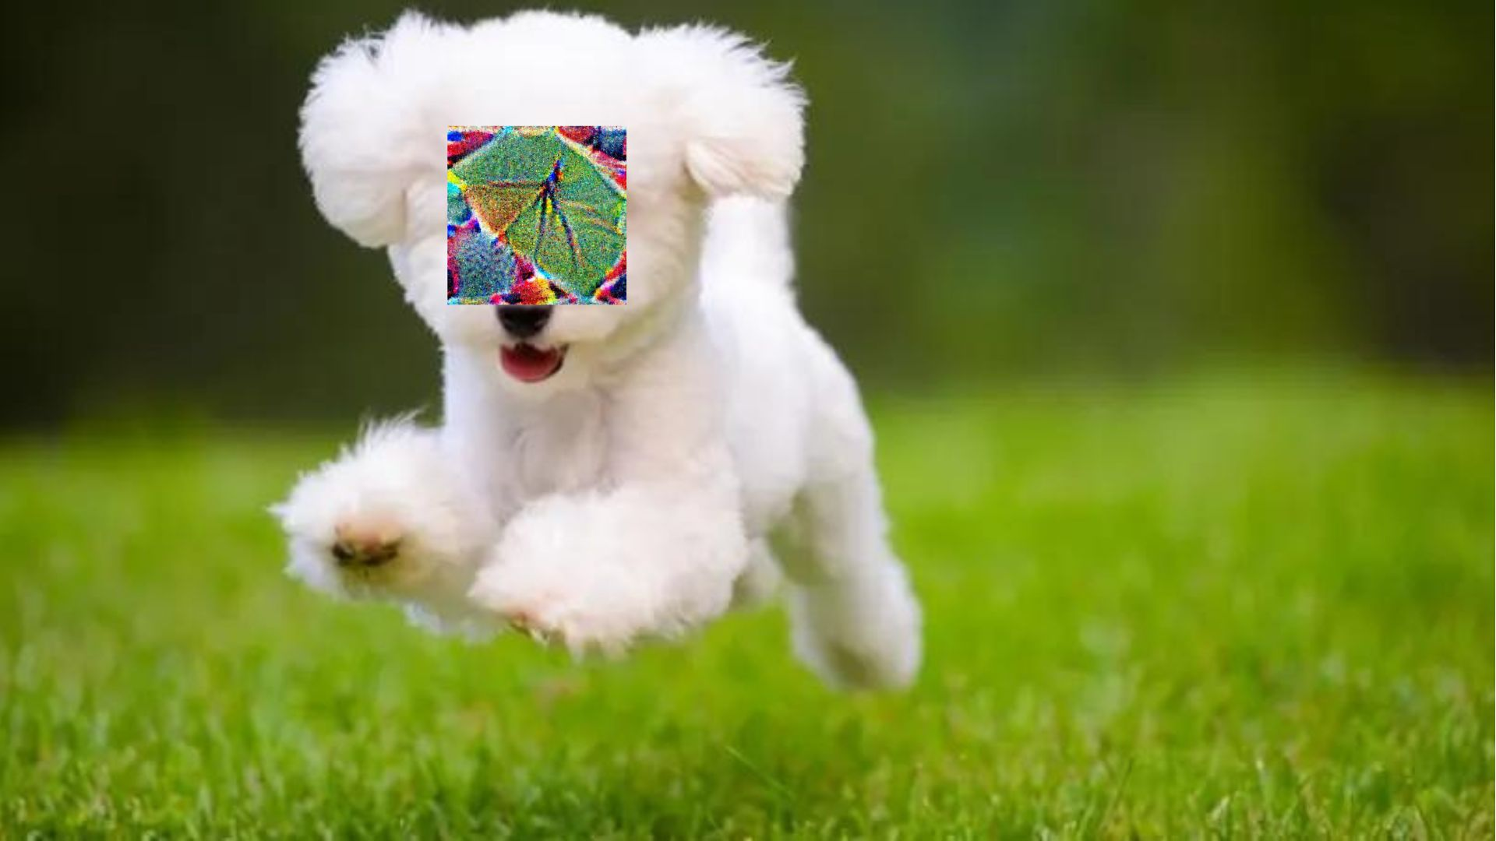
Adversarial Patches Terrelle Thomas*, Idongesit Mkpong-Ruffin*, Chutima Boonthum-Denecke** FAMU Dept of Computer & Information of Sciences*, Hampton University, Dept of Computer Science**
Purpose
Materials
Results
Discussion
The aim of this research is to understand how adversarial patches affect the normal functioning of AI models. The objective is to examine how these patches when overlaid on an original image, cause the model to produce inaccurate predictions. Metrics such as prediction accuracy, confidence levels, and other relevant factors will be studied to understand the impact of these patches on the model’s performance. The goal is to develop a defense strategy using a Generative Neural Architecture (GNA) with a three-pipeline anomaly detection system. This strategy aims to mitigate the effectiveness of adversarial patches by thoroughly analyzing how these patches interfere with the model’s predictions.
Detection Model: Yolov8
Programming Language: Phyton
Electronic: Laptop, Phone
Adversarial Patches
The results of both experiments have shown that when adversarial patches are added, disturbances known as perturbations are introduced into the scene. These disturbances become trapped in the grid when the AI model segments the scene, causing the model’s metrics, such as confidence rates, to fluctuate. Articles such as "X-Detect: Explainable Adversarial Patch Detection for Object Detectors in Retail" help illustrate that when adversarial patches are bound within the segmented grid, they generate disturbances. These disturbances, when contained in the grid, lead to fluctuations in the model’s metrics such as confidence rates and percentages. These findings helps to the emphasize the harmful impact of adversarial patches have on AI models. By showing how inherent and overlaid perturbations lead to inaccuracies in detection systems, our results highlight the critical need for robust defense mechanisms against adversarial attacks.
Experiment 1
Hypothesis
Methods
It is hypothesized that when adversarial patches are added, disturbances, called perturbations, are introduced into the scene. The disturbance gets trapped in the grid when the AI model segments the scene, causing the model’s metrics, such as confidence rates and percentages, to fluctuate. These disturbances can sometimes cause the model’s predictions and confidence rates to fluctuate.
Experiment 1: Detection
The original picture is positioned before the detection system to facilitate identifying and classifying its content.
Results obtained from the detection system are recorded.
When the patch is overlaid onto the original picture, analysis and results from the detection system are recorded.
The detection results obtained before and after overlaying the patch on the original picture are analyzed, and the impact of the original image and the overlaid patch on the predictions is recorded and assessed.
Experiment 2: Detection Based on Confidence Rates and Predictions
Without Patches
Using Python Code:
The original picture is coded into the detection system to facilitate identifying and classifying its content.
Results are recorded, including prediction and confidence rates from the detection system.
When the patch is overlaid onto the original picture, analysis and results from the detection system are recorded using the command line.
The detection results obtained before and after overlaying the patch on the original picture are analyzed, focusing on the differences in prediction accuracy and confidence rates.
Using the Camera:
The original picture is placed in front of the detection system using a phone to identify and classify its content.
Results are recorded, including prediction and confidence rates from the detection system.
When the patch is overlaid onto the original picture, analysis, and results from the detection system are recorded using the phone camera.
The detection results obtained before and after overlaying the patch on the original picture are analyzed, focusing on the differences in prediction accuracy and confidence rates.
With Patches:
Using Python Code:
The edited picture is coded into the detection system to facilitate identifying and classifying its content.
Results, including prediction and confidence rates obtained from the detection system, are recorded.
Using the Camera:
The edited picture is placed in front of the detection system using a phone to identify and classify its content.
Results, including prediction and confidence rates obtained from the detection system, are recorded.
Image | Dimensions | Object Detected | Percent | Preprocess Speed (ms) | Inference Speed (ms) | Postprocess Speed (ms)
O-Cow.jpg | 384x640 | Cow | >70% | 4.1 | 895.3 | 8.0
O-Puppy.jpg | 384x640 | Dog | >70% | 4.4 | 944.2 | 7.0
Background
Artificial intelligence involves developing computer systems capable of performing tasks that typically require human intelligence, such as visual perception and speech recognition. The paper’ Adversarial Patch' by Tom B. Brown et al. examines how specifically crafted inputs, such as 3D image-like patches of a toaster, can be inserted into a scene (e.g., a tabletop with a banana and notebook) to deceive or manipulate machine learning models. This type of attack is known as an adversarial patch attack.
Previous research, such as ‘X-Detect: Explainable Adversarial Patch Detection for Object Detectors in Retail’ by Omar Hofman et al., has shown that attackers meticulously select human-edited, computerized inputs—such as 3D image-like patches, like a toaster placed in a tabletop scene alongside a banana and notebook—to deceive or manipulate AI models. This type of attack is known as an adversarial patch attack. Attackers deploy adversarial patches with varying characteristics across different scene sections where object detection occurs.
Articles such as 'An Improved YOLOv8 to Detect Moving Objects' provide an overview of how YOLOv8 is built and detects objects within a scene. This understanding helps explain how disturbances, called perturbations, can become trapped in the grid when the AI model segments the scene during object detection.
We aim to emulate these methodologies to understand better how adversarial patches affect the normal functioning of AI models. With this understanding, we can develop a strategy to mitigate the impact of these patches on AI models. Our approach uses a Generative Neural Architecture (GNA) with a three-pipeline anomaly detection system. The research’ Anomaly Unveiled Inspires this Strategy: Securing Image Classification against Adversarial Patch Attacks by Nandish Chattopadhyay et al. As the data progresses through the three-step pipeline, it undergoes a comprehensive comparison, analysis, and refinement focused on detecting anomalies. This process continues until the data is returned to its original state, effectively neutralizing its potential to act as an adversarial patch.
Conclusion
In conclusion, when adversarial patches are added, disturbances known as perturbations are introduced into the scene. When these disturbances become trapped in the grid when the AI model segments the scene, and their presence leads to fluctuations in the model’s predictions and confidence rates/percentages. The presence of both inherent and overlaid perturbations significantly contributes to inaccuracies in model predictions, highlighting the importance of considering such factors in model development and assessment. Understanding how adversarial patches work helps us recognize how adding these patches to a scene with an AI model can affect the model’s performance. This knowledge will aid in the future development of a defense strategy utilizing a Generative Neural Architecture (GNA) equipped with a three-pipeline anomaly detection system to mitigate the impact of adversarial patches on AI models.
Image File | Resolution | Objects Detected | Percentage | Preprocess Speed | Inference Speed | Postprocess Speed
E-Cows.jpg | 384x640 | dog | 62% | 7.6ms | 1329.7ms | 18.8ms
E-Dog.jpg | 384x640 | person | 75% | 56.8ms | 1575.0ms | 39.7ms
Experiment 2
(b)
Acknowledgements
This material is based upon work supported by the National Science Foundation under Grant No. (2131256 ) and the FAMU Title III Undergraduate Research Program Project 40023 and the FAMU Office of Undergraduate Research.

